Slide 1








INTRODUCTION TO THE
BLOCK PREPAREDNESS COORDINATOR PROGRAM
Ken Dueker, J.D.
Director
Emergency Services
Annette Glanckopf
Chair, PAN EPREP Committee

Slide 2
Housekeeping
Sign in
Cell Phone
Side Conversations
Questions
Restrooms
ICE

Slide 3
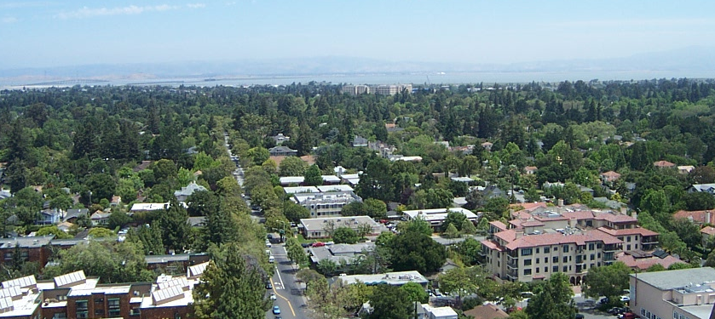
The Palo Alto Problem
The daytime population in Palo Alto is well over 70,000. Add another 35,000 for normal Stanford campus population – can be up to an additional 100,000 during Stanford Football + holiday shopping season.
61,200 PA residents in 27,000 single and multi-family dwellings in 30 neighborhoods over 26 square miles
There are roughly 6,000 business with 100,000+ employees. Some are (should be) disaster resources.
How many Police Officers on duty now?

Slide 4
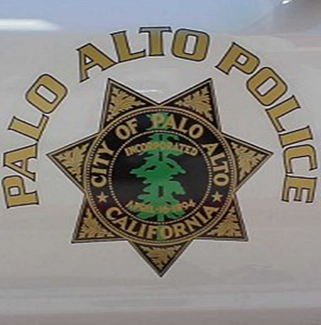

City Response Staffing
There are only 24 firefighters on duty on any given day.
(It takes approx. 15 -20 firefighters to respond safely to one
full-structure incident.)
There could be as few as 8 police officers on patrol duty.
      Daily Calls (911) for Incidents:
      Police Dept. - 170
      Fire Dept. - 20 (primarily EMS medical)
There are 40 Utilities operational personnel for Electrical Operations and 30 in Water, Gas, and Wastewater.
There are 40 Public Works operational personnel

Slide 5
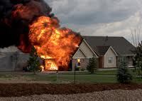
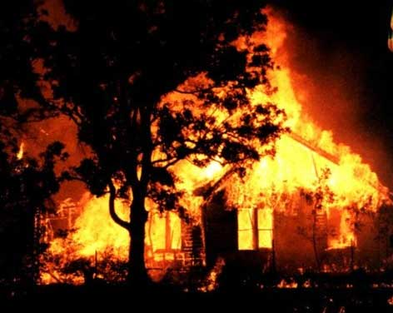
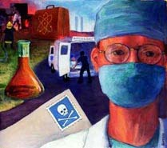
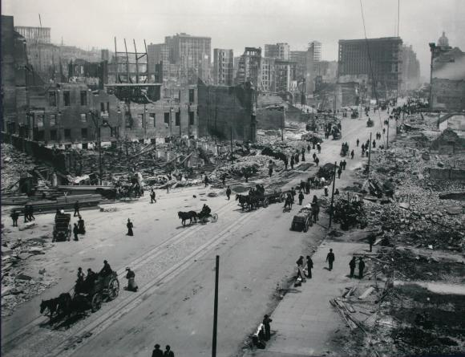
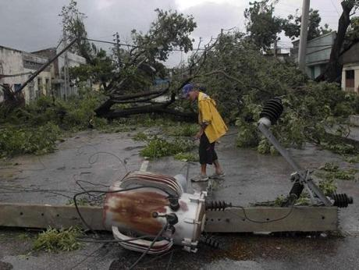

Slide 6
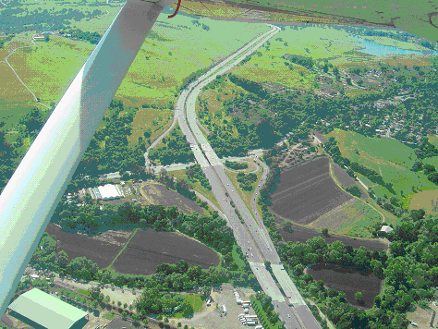
Core Goals
Residents and businesses (etc.) are resources, not victims.
PEOPLE, not plans in a binder, are the key to response and recovery. Must have COMMUNICATIONS to achieve.
Community can provide information to City:
Initial Damage Estimate
Transportation Status
Incident Reporting
Resource Sharing
“Eyes and Ears” Function

Slide 7
THE BPC PROGRAM
DEFINED

Slide 8
Block Preparedness Coordinator
Program
Partnership between Community and City
Establishes communications links to “blocks” (residences & businesses)
Promotes resilient community / self-sufficiency
Ties non-governmental entities to the Incident Command System (ICS).
Motto: “Changing the role of community members from victims to partners in disaster recovery.”

Slide 9

BLOCK PREPAREDNESS COORDINATOR
Crime
Emergency
Disaster
Information Sharing
Social

Slide 10
BPC Key Activities
Meet your neighbors
Create a neighborhood list (directory) for use in activity planning and emergencies. Provide each neighbor with the list. Distribute OK/HELP signs to each neighbor.
Create a phone tree for communications
Distribute information from the Neighborhood & the City; communicate needs and issues upwards to Neighborhoods to City/Council
Serve as communication node for emergency/disaster
Prepare an Emergency Response Grab-Go Bag
Plan an event once a year
  Block party
  Crime Safety Meeting

Slide 11
MEET NEIGHBORS
Individual Contact with each household
Distribute “Hello Neighbor” Letter
  We will visit you soon
  Here is who we are + Our contact Info
  Information sheet for them to complete
  Eprep web sites
    www.paneighborhoods.org/ep
    www.cityofpaloalto/emergency volunteers

Slide 12
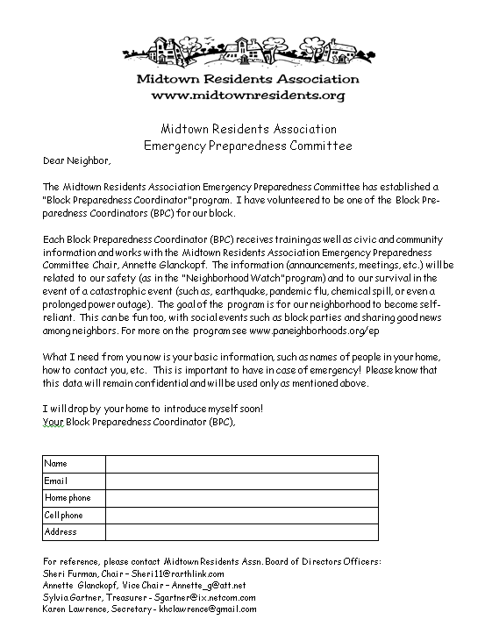

Slide 13
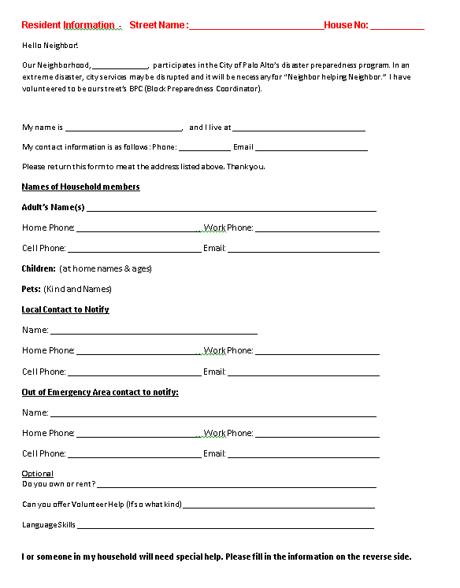

Slide 14
FOLLOW-UP VISIT TO NEIGHBOR
Pick up Information Sheet
Deliver packet of materials & explain importance,
  Neighborhood Lessons Learned - 15 steps to Preparedness
  Help/OK handout: Explain how to use this in times of disaster so that time not wasted
  Family emergency plan
  Emergency supplies checklist
  Encourage everyone to sign up for ALERTSCC
  Role of a BPC in a disaster/emergency
Develop Neighborhood list, phone tree, runners

Slide 15
PERIODIC MESSAGES
Welcome New Neighbors
Messages from OES (Office Emergency Services), City of Palo Alto, Neighborhood
Eprep Tips
Thanksgiving or Daylight Savings Time
  Check on supplies & replace if outdated
      Batteries
      Food
      Water

Slide 16
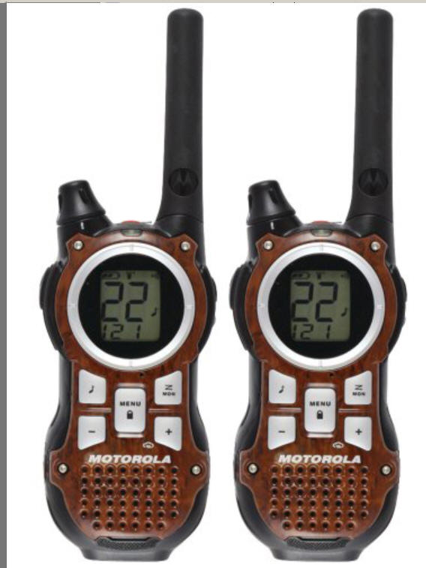
BUY FRS RADIO

Slide 17
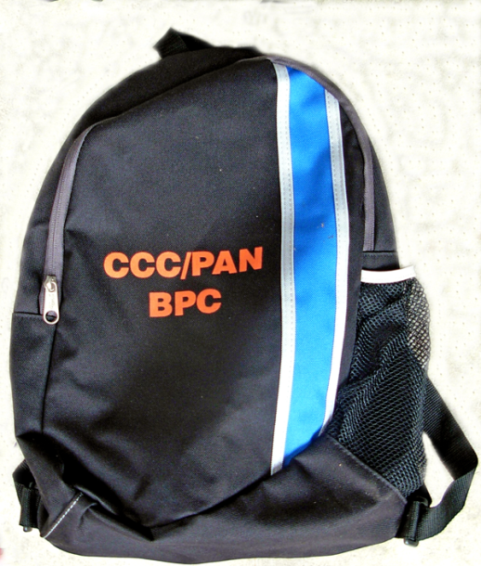
BUILD A BPC
EMERGENCY RESPONSE BAG
Recommended Items
  VEST/Cap/ID badge
  FRS/GMRS radio + Additional batteries
  Flash light (1-2)
  Clip board with Blank paper for notes & water proof pen(s)
  Block maps + Map of location of your NPC & closest NPCs .
  Hardcopy neighborhood list of names and contact information
  Additional contacts
  Radio instruction sheet / NATO alphabet
  Blank (or pre-filled out) DA forms
  First aid kit (small)
  Tissue pack
  Whistle on lanyard
  Water (bottle), snacks
  Other: Duct tape, gloves

Slide 18
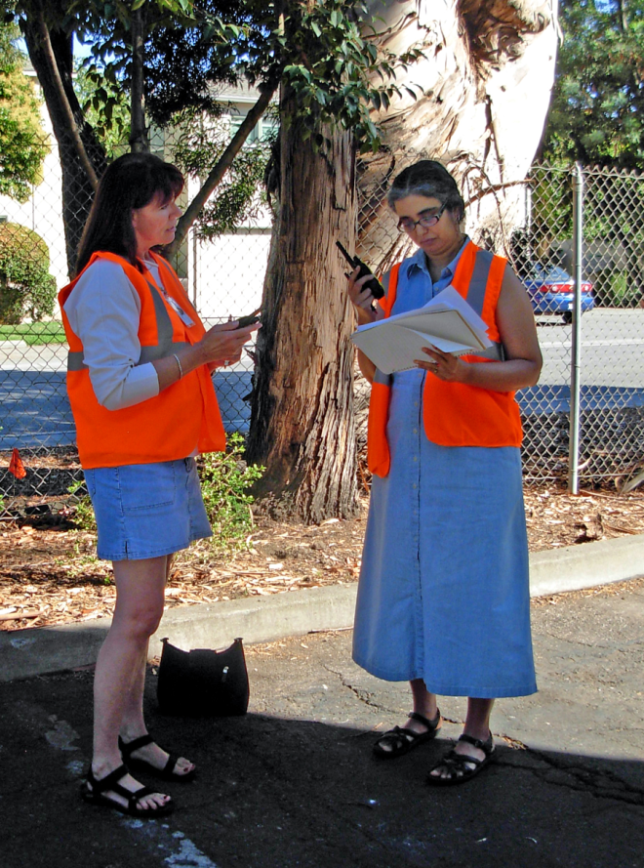
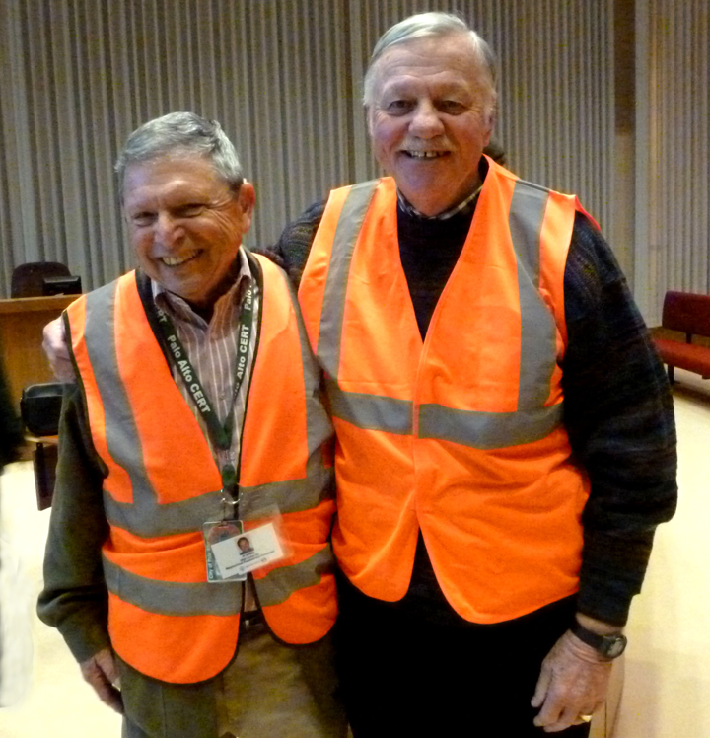
RECRUIT CO-BPC

Slide 19
INSTALL A LAWN SIGN

Slide 20
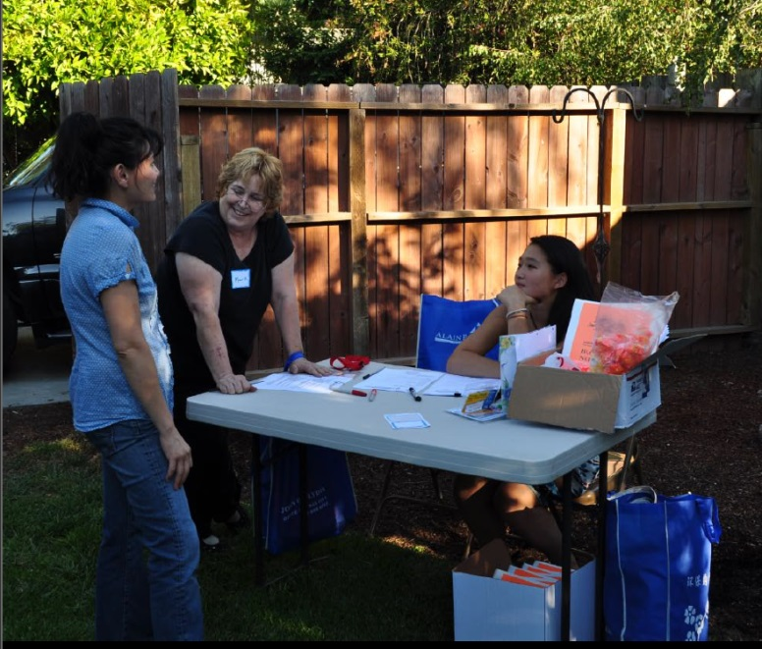
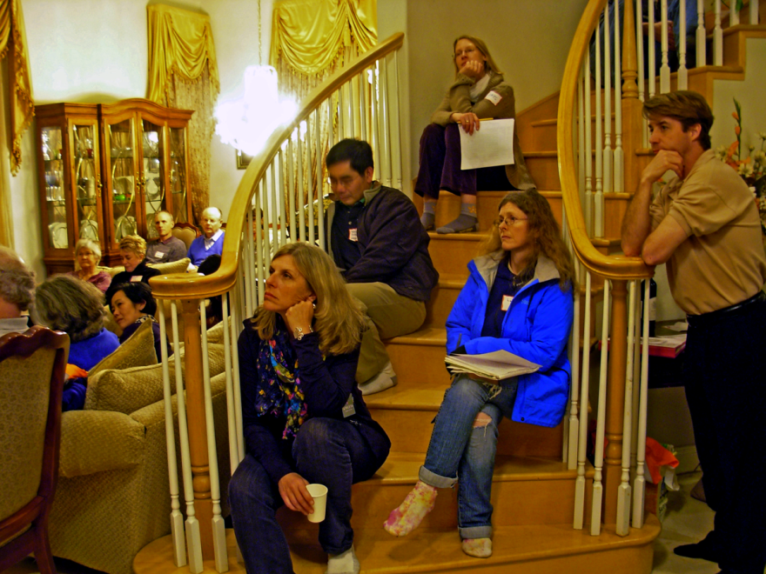
HOLD AN ANNUAL EVENT
Crime Prevention
Soup Night
Block Party
Personal Preparedness
etc

Slide 21
BPC ANNUAL REQUIREMENTS
Participate in quarterly Neighborhood Radio check-ins
One class or event
One drill
Annual recognition/kickoff meeting

Slide 22
Neighborhood Preparedness Coordinator Key Activities
Coordinate emergency/disaster preparation for the neighborhood
Neighborhood Association Committee Representative
Serve as a communication node for your Neighborhood
Point of contact during a disaster
Coordinate BPCs, Neighborhood CERTs & Disaster Communications

Slide 23
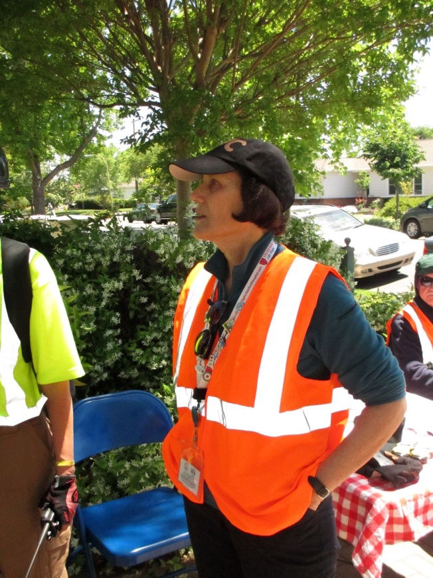
MEET YOUR NPC
Introductions
Get ID, Vest, Cap
Get BPC #
Identify your “block”
Verify communication
channels
Etc

Slide 24
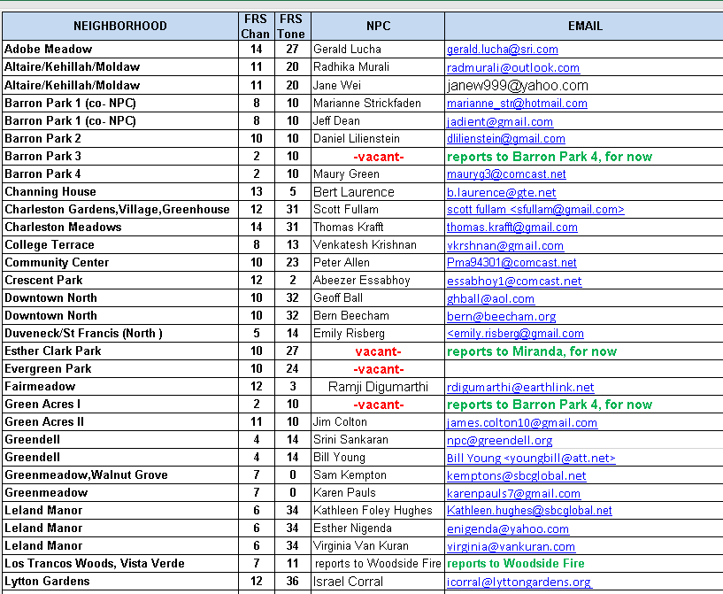
Palo Alto NPCs

Slide 25
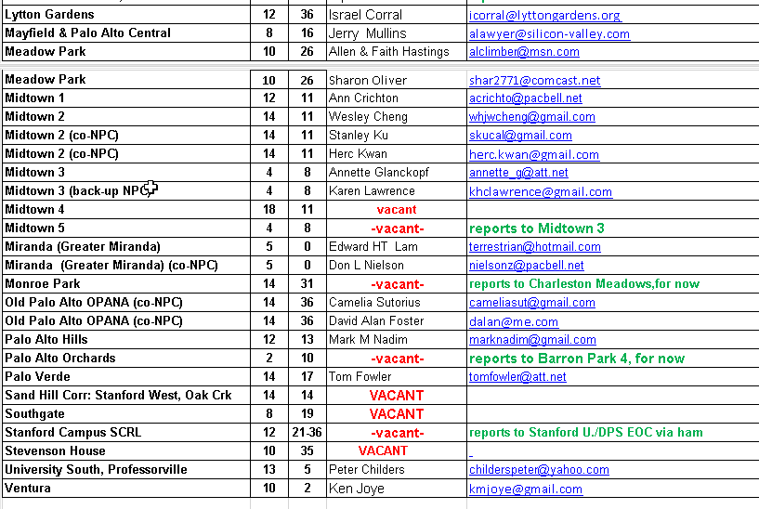

Slide 26
BPC & NPC Training
Core Modules
Total 3 hours for BPC Certification training
  Neighborhood Organization
  Communications - Radio I01
  Damage Assessment
NPC Training, in addition to BPC Certification training:
  Installation of MURS radio
  Radio 102
  ICS online courses
Other Optional Training
  Radio 102,
  Crime Safety
  First Aid/CPR

Slide 27
GET INVOLVED
Descrptions, SOP, Class Calendar, Maps
http://www.cityofpaloalto.org/services/public_safety/get_involved/default.asp
http: www.cityofpaloalto.org/emergencyvolunteers

Slide 28
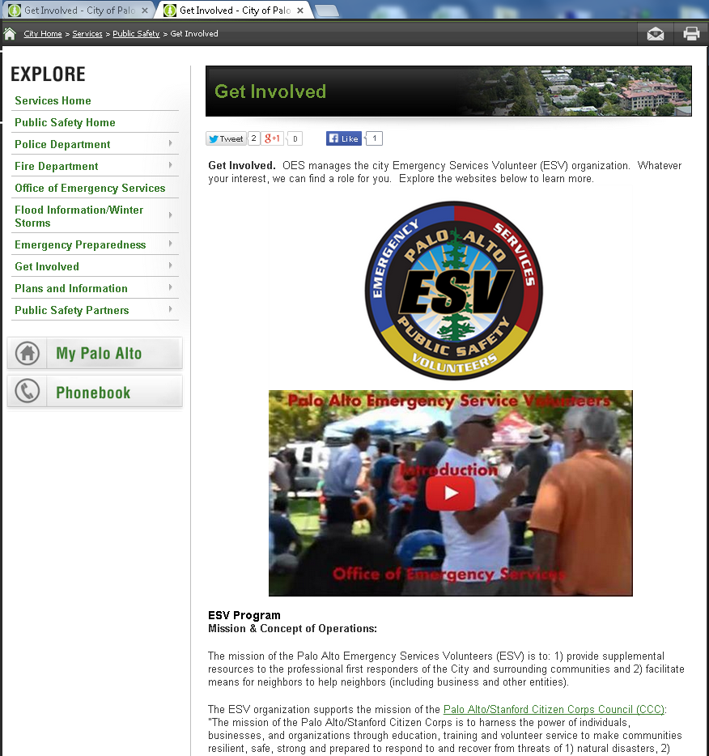
Scroll
Down

Slide 29
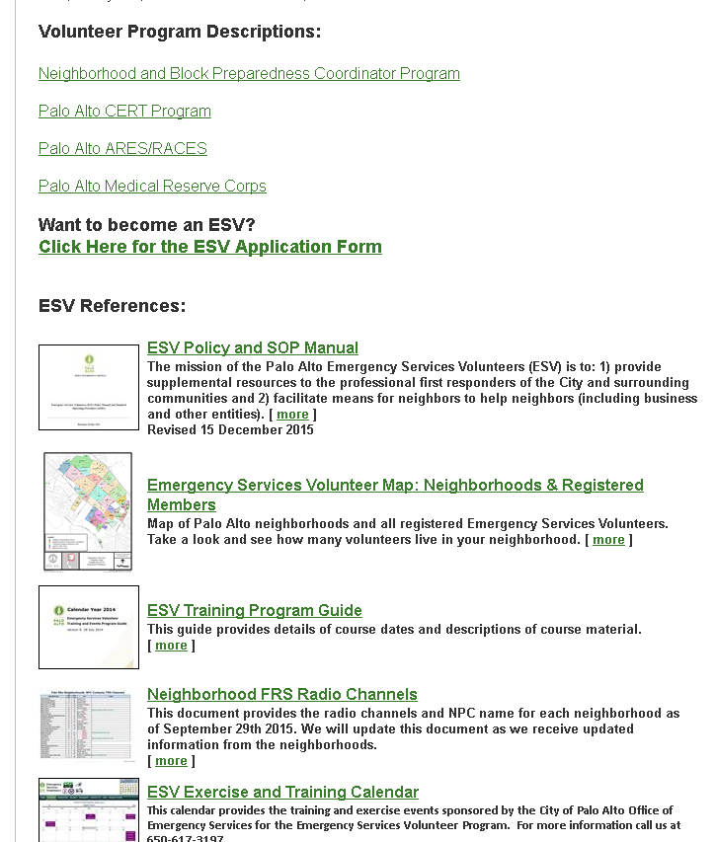

Slide 30
Compare BPC & CERT
Palo Alto CERTs:
  Palo Alto’s Community Emergency Response Team (CERT)
  CERTs are OES volunteers
  20 hours of training in light search and rescue, etc.
  Neighborhood CERTs & Citywide CERTs
Block Preparedness Coordinators (BPC)s:
  Community volunteers
  Receive 3-4 hours of training from PAN and Police Department
  Stay in their neighborhoods on their block

Slide 31
Communications Links
Palo Alto City
(Mobile) Emergency Operations Center ((M)EOC)
ESV DOC (if not established, NPCs, etc. go direct to EOC)
Ham Radio
Citywide CERT Field Teams
MURS Radio
Neighborhood Preparedness Coordinator
FRS/GMRS Radio
FRS/GMRS Radio
Block Preparedness Coordinators
Neighborhood CERTs

Slide 32
GOAL
Role for anyone who wants to participate
Identify points of support in the community
Train – sooner rather than later

Slide 33
IN CONCLUSION
The BPC Program is about neighborhood awareness and readiness, neighbors helping neighbors, more importantly, your safety as a BPC and doing the greatest good for the greatest number.
On behalf of the PAN E-Prep Committee, we want to express our sincere gratitude for your support and contribution to our neighborhood. You are the neighbors who are helping neighbors.

Slide 34
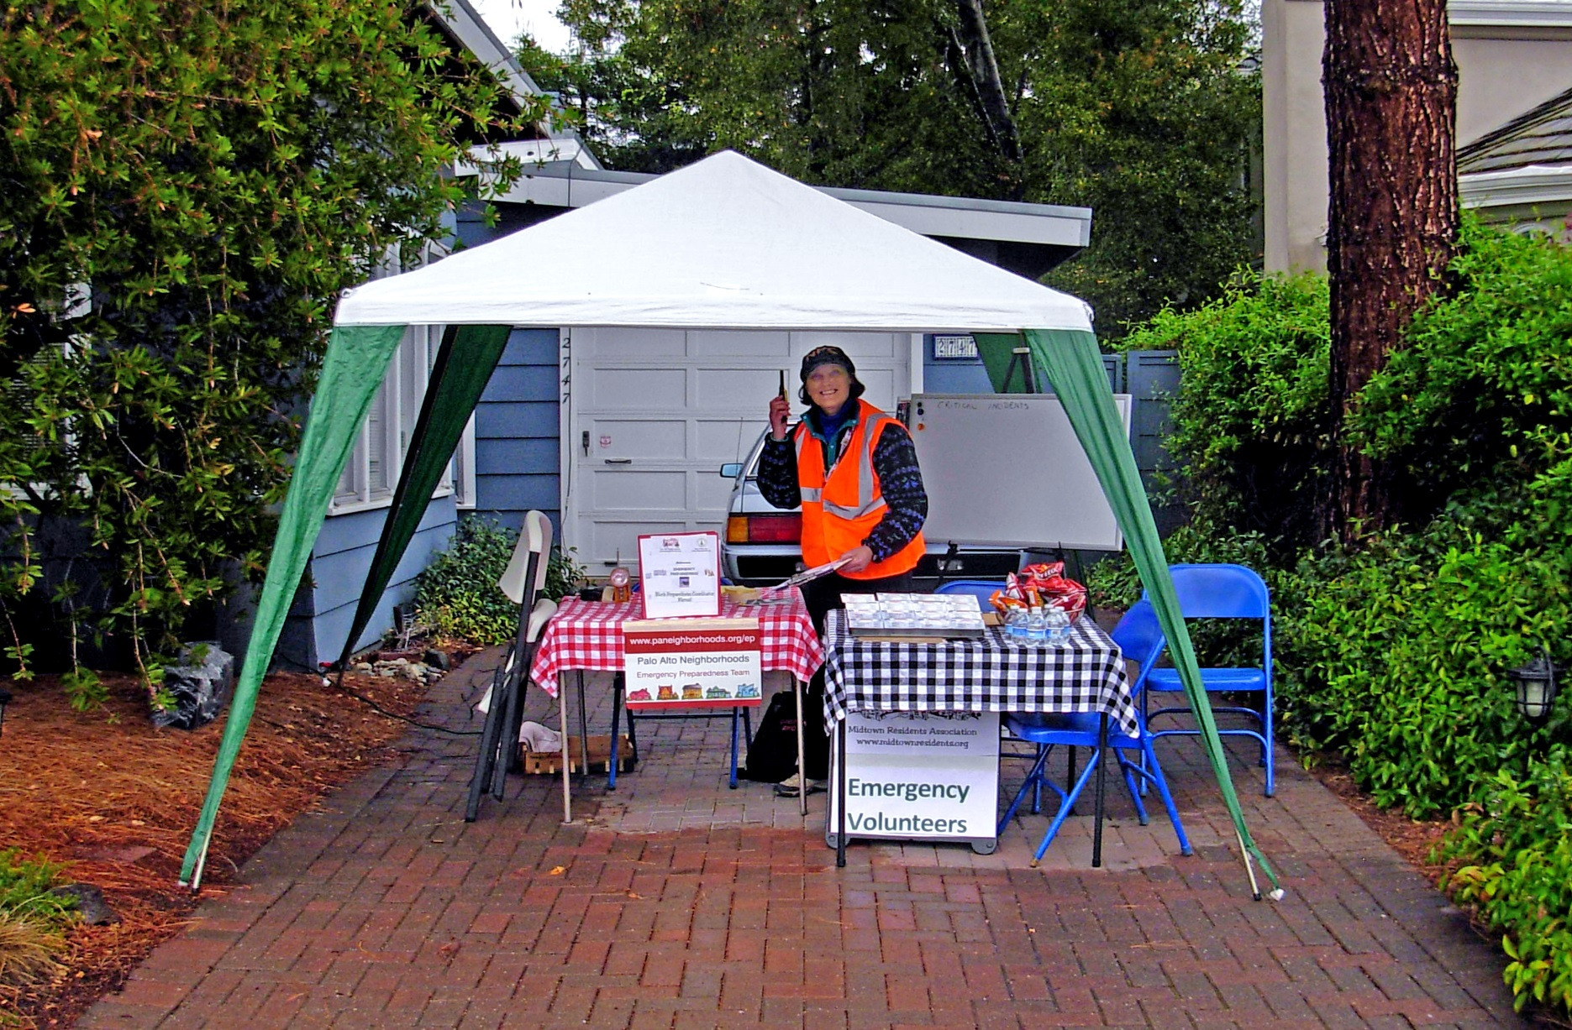
Join us, don’t be on your own

